Slide 1
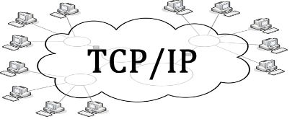
IP/TCP
IP stands for internet protocol and is a number used to indicate the location of a computer or other device on a network using TCP/IP. Also it allow data to reach the appropriate destination on a network and the Internet.
TCP stands for transmission control protocol this is ensuring the transmission is reliable for the data access. Also TCP checks for errors and submits requests for re-transmissions if any are found.

Slide 2
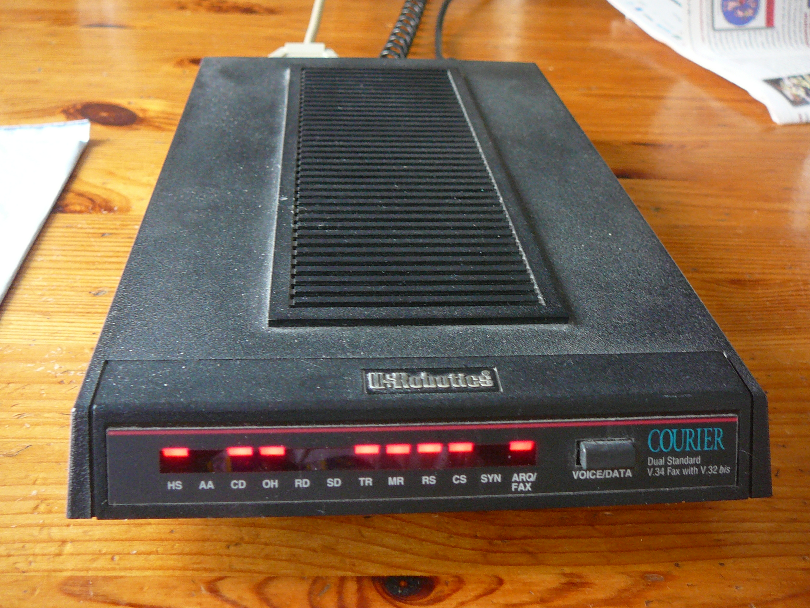
Dial Up
Dial up is a form of internet access that connects to your phone line by a modem which allows you to use the internet. Also Dial up is a old from of internet connection and it is very slow and you can use the phone as you are using the internet. Also Dial up is not used much today because of Ethernet and wireless but in parts of the country still use Dial up because they can not connect to the internet wirelessly or by Ethernet because the wire that make it work have not been put in.

